Slide 1
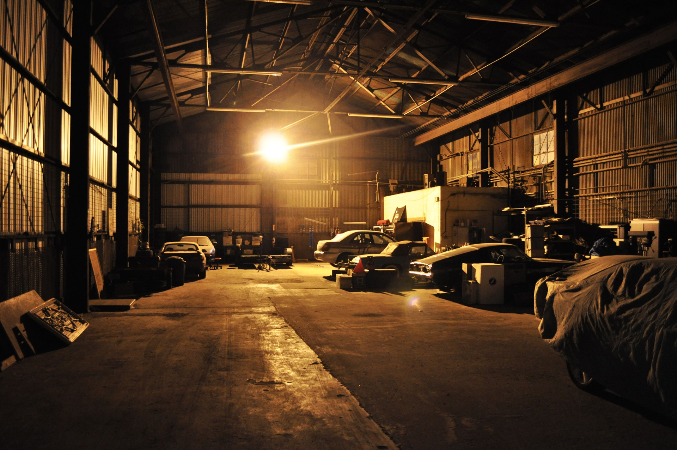

AUTOMOTIVE EXPERT SYSTEM
AMMAR SYATBI
MUHAMMAD IRFAN

Slide 2

INTRODUCTION
As we all know , modified cars are increasing these day usually seen in the street or in workshops. Most of this modifiers or tuners are car enthusiast or motorsports fan. Even for standard car user there must be time upgrading is needed. No matter in what category people would still have problem in determining parts to upgrade. It is a human nature to have the very best we can get on everything we have. Automotive Expert System was designed to fulfill that needs. Although the system is consider small that it covers only standard cars and 4x4 vehicle but it has wide range of parts and substantial expertise on solving problems. With great interface design and system flow , user can have the ease of use thus spend shortest time possible on finding the right parts.

Slide 3
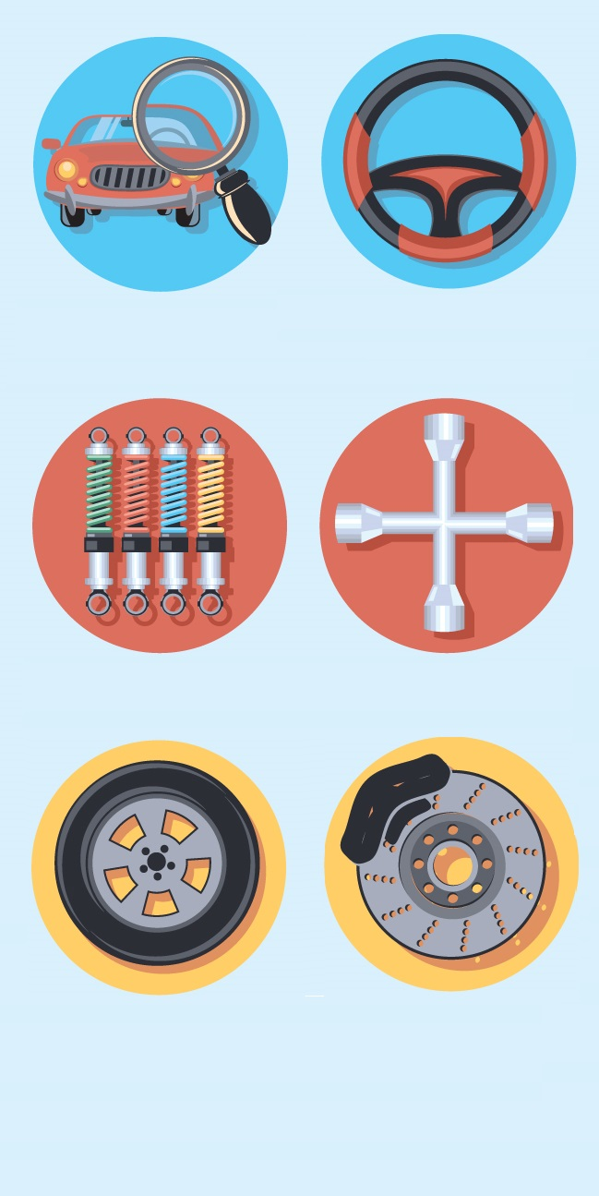


PROBLEM STATEMENT
Mechanic having problems on memorizing upgrade compatibility.
Motorsport enthusiast having problems on choosing the right parts.
Choosing the wrong parts can cause continuous damage to other parts of the car system.

Slide 4
OBJECTIVES
To assist mechanic to upgrade car performance.
To guide motorsport enthusiast who want to upgrade their car.
To avoid negative effects on parts of car due to choosing the wrong parts.
SCOPE
Guidance for novice mechanics and motorsport enthusiast who want to upgrade their car.

Slide 5
INPUT / OUTPUT
INPUT
OUTPUT
MODEL
Car model
Purpose
Categories
Parts
Explanation
Photos
PURPOSE
CATEGORIES
OUTPUT

Slide 6
GANTT CHART
Year 2016 | MARCH |  |  |  | APRIL |  |  |  | MAY |  |  |  | JUNE
Activity | W1 | W2 | W3 | W4 | W5 | W6 | W7 | W8 | W9 | W10 | W11 | W12 | W13 | W14 | W15 | W16
Choose title & team members
Developing proposal
Proposal submission
Collect data
Developing Decision Tree
Submit Decision Tree
Proposal Presentation
Developing Expert System
Testing Expert System
Preparing presentation & report
Final Presentation & report submission

